Slide 1

Online Stationery Store
Group Members
1)Lakshit Patil - 20104043
2)Siddhant Darekar-20104111
3)Shreyas Ghute-20104051
4)Kaif Khan-20104128
Project Guide
Ms. Shafaque Syed

Slide 2
Contents
Introduction
Objectives
Scope
Features / Functionality
Project Outcomes
Technology Stack

Slide 3
1. Introduction
Online Stationary Store is a form of electronic commerce where consumers directly buy goods or services from a seller over internet without an intermediary service.
This project is an attempt to provide the advantages of online shopping to customers of a real shop.
It helps buying the products in the shop anywhere through internet.
The customer will get the service of online stationary store and home delivery.

Slide 4
2. Objectives
To provide a registration page for User.
To provide login page for Admin and User.
To provide a system where the stock available in shop will be displayed to customer.
To provide a page for adding/deleting products.
To provide a system where user can place order of any item available in the stock.
To provide online payment system for the customer.

Slide 5
3. Scope
This system can be implemented to any shop in the locality having retail outlet chains.
The system recommends a facility to accept the orders 24*7 and a home delivery system which can make customers happy.
If shops are providing an online portal where their customers can enjoy easy shopping from anywhere, the shops won’t be losing any more customers to the trending online shops such as Flipkart or Amazon.

Slide 6
4. Feature /Functionality
All the users can view various products, if they wish to buy any then they have to register and then login to add that product inside their cart.
The users or customers can also read the reviews about a product posted by other users before buying it.
The users can add as many products he/she wants to their shopping cart.
Then the users are able to set the quantity of each added product inside the cart.
Finally, while checkout the users can give their address and the mode of payment and place the respective order.

Slide 7
Features:
User Authentication (Register and login)
Session of each user is saved using cookies.
All Products with their available stock, price, product review, option to place and cancel the orders.
Users are able to search for any stationery product.
Users can review a product purchased.
Proper Order Summary Before Placing Order.

Slide 8
5. Outcome of Project
A simple online shopping app designed for all stationery requirements.
The user can check the available products in the stock.
User can also place order for the product/s he/she is in need of.
Cancellation of the order is easily available to the user.
This application can be very useful in times like the covid, where no one can come out of there houses.

Slide 9
6. Technology Stack
Programming language:- Python
Operating System:-Windows 11
Development Environment:-Visual studio
Database:- Mysql-server

Slide 10
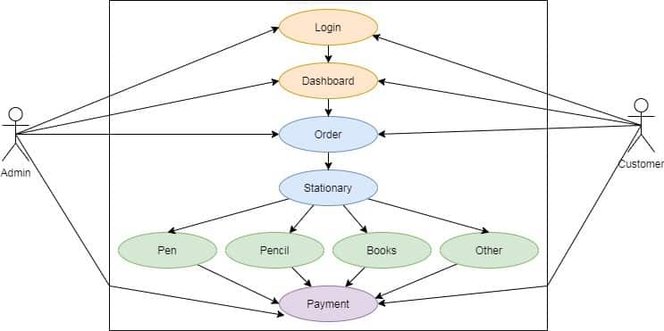
Use Case Diagram:

Slide 11
Thank You...!!

